Slide 1

University of New Haven- Tagliatela College of Engineering DSCI-6612-02 Distributed & Scalable Data Engineering
TEAM-04
Smart-Autonomous Vacuum Cleaner

Slide 2

Top 3 Robot Vacuum Cleaners
1. Roborock S8 MaxV Ultra
2. Ecovacs Deebot X8 Pro Omni
3. iRobot Roomba j9+

Slide 3

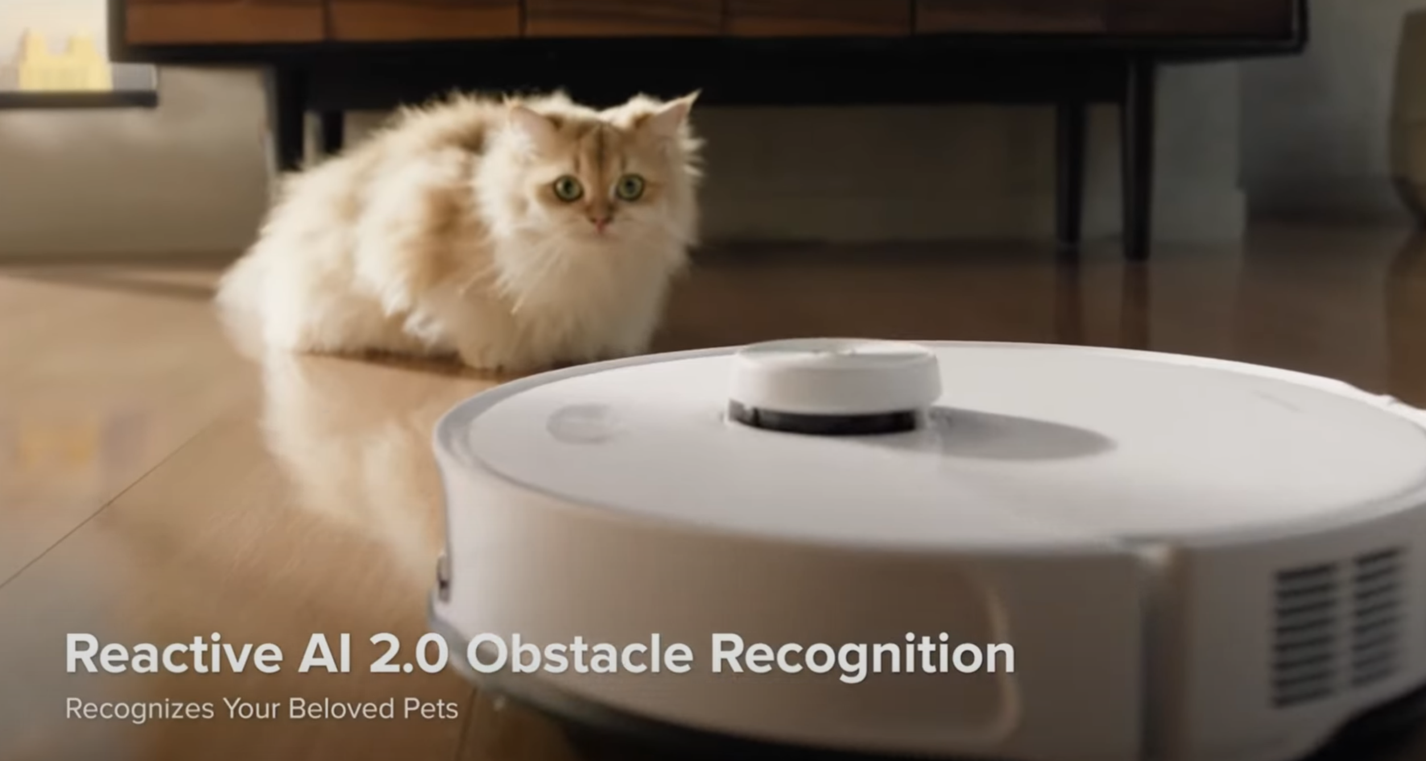
1. Roborock S8 MaxV Ultra
💬 “The ultimate robot vacuum – does everything so well, you forget you own it.”
Suction Power – 10,000Pa
AI Obstacle Recognition – 73 objects
Limitations:
Dark Dust
Manual Suction adjustment
Fails on thresholds above 1.5 cm
Patent:
AI Obstacle Recognition and LiDAR

Slide 4


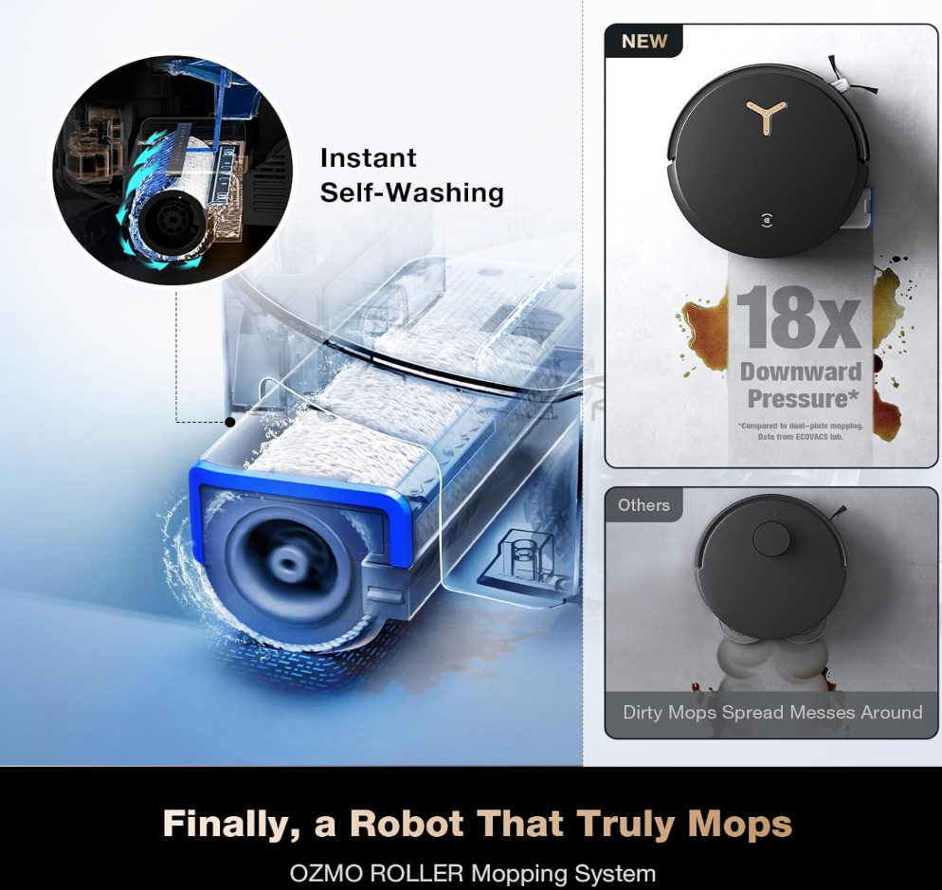
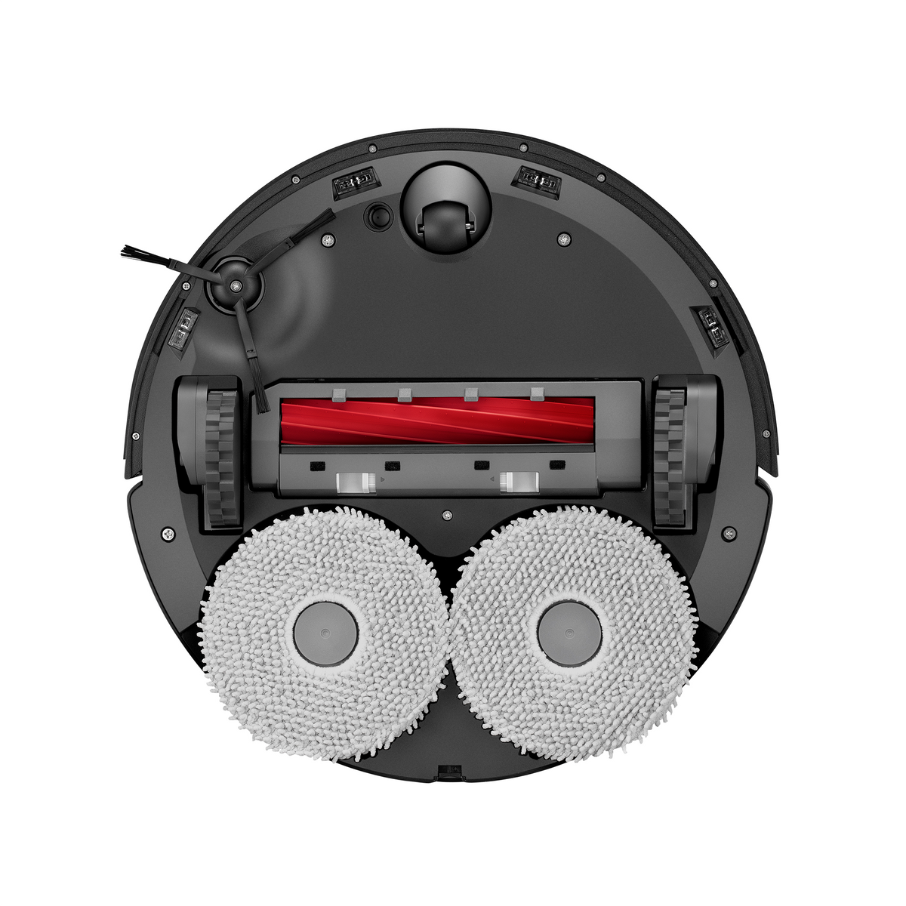
2. Ecovacs Deebot X8 Pro Omni
🧼 “Mop king of all robots ⚠️ Slightly overpriced”
ZeroTangle 2.0 Brush
TruEdge Sensor
OZMO Roller Mop
Limitations:
🗣️ Voice assistant commands are limited
Struggles with high thresholds
Patent:
Self-Movement Robot with 3D Mapping

Slide 5

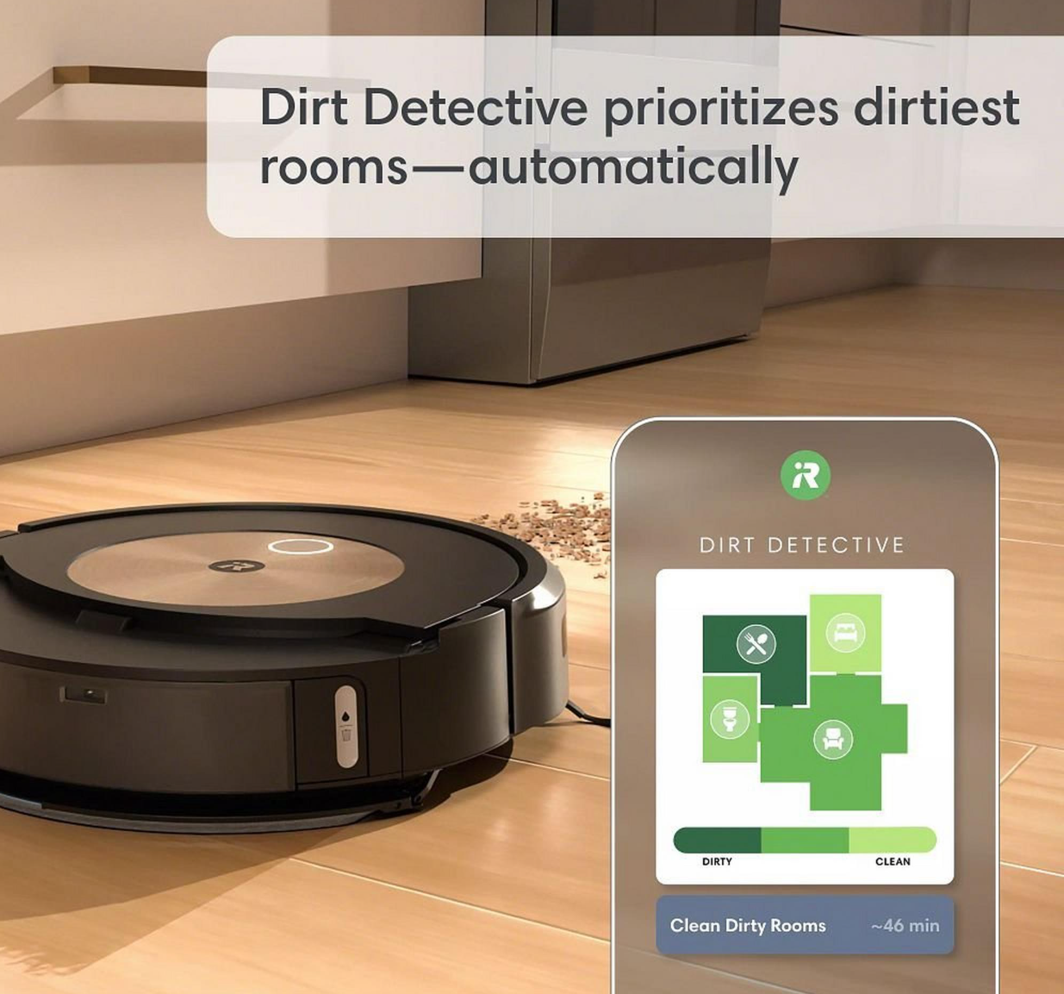
3. iRobot Roomba j9+
💬 “Perfect for pet messes, and the self-emptying bin is a game changer.”
Dirt Detective™ by iRobot OS 7.0
Limitations:
No Mop Integration
Weaker Suction Power
Navigation Struggles
Patent:
Clean Base® Automatic Dirt Disposal

Slide 6
Hardware Implementation – AI Smart Vacuum Cleaner
This section explains how the AI model was integrated into real hardware to build a working smart vacuum cleaner.
Focus on real-time execution using Raspberry Pi and GPIO.
Hardware enables the AI model to interact with the physical world.
Covers motor control, vacuum triggering, and component interfacing.
Designed to operate autonomously based on CNN predictions

Slide 7
Project Overview
This project aims to design and implement an AI-powered smart vacuum cleaner using Raspberry Pi. The system uses a Pi camera to capture real-time floor visuals, which are analyzed by deep learning models trained to detect dust and recognize stairs. Based on these predictions, the vacuum robot autonomously decides whether to clean, move, or climb. When stairs are detected, the bot engages a gear-driven wheel mechanism that allows it to ascend steps smoothly and maintain stability. The entire setup integrates GPIO-controlled DC motors for movement, a vacuum pump activated via a relay for dust cleaning, and intelligent control logic — resulting in a compact and robust AI-embedded hardware system capable of operating across multiple floor levels.

Slide 8
Components To be Used
Component | Purpose
Raspberry Pi 4 (4GB+) | Acts as the brain of the system; runs CNN models and controls GPIO
Pi Camera Module | Captures real-time floor visuals for dust and stair detection
Vacuum Motor (12V) | Creates suction to clean dust
Relay Module (1-channel) | Switches vacuum motor ON/OFF based on AI output
DC Gear Motors (x2) | Drives wheels with enough torque to climb stairs using gear-driven motion
Gear-Driven Wheel System | Provides stair-climbing ability; mechanical attachment to motor shafts
L298N Motor Driver | Controls direction/speed of both motors through Raspberry Pi GPIO

Slide 9
Components To be Used
Rechargeable Li-ion Battery (12V, 2–4A) | Powers motors and vacuum (through relay)
Power Bank (5V, 2A) | Powers Raspberry Pi separately
Chassis Frame (Lightweight) | Holds all components; choose acrylic or aluminum for strength vs. weight
Jumper Wires + Connectors | Connects GPIO pins to modules and motors
Screws, Mounts, and Casings | Assembles and secures components to the chassis
Rechargeable Li-ion Battery (12V, 2–4A) | Powers motors and vacuum (through relay)
Power Bank (5V, 2A) | Powers Raspberry Pi separately
Chassis Frame (Lightweight) | Holds all components; choose acrylic or aluminum for strength vs. weight

Slide 10
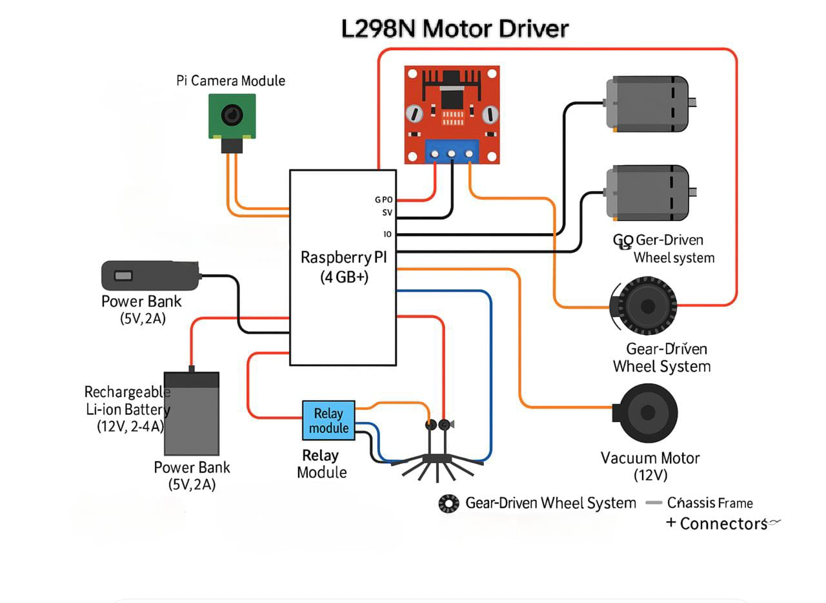
Hardware Circuit Design

Slide 11
Code & Control Flow
• GPIO setup using RPi.GPIO
•cv2.VideoCapture(0) to get camera feed
• CNN model prediction decides:
o If dusty → Vacuum ON
o If stair → Stop or climb
o Else → Move to new tile ok now guide me what to add in this slide

Slide 12
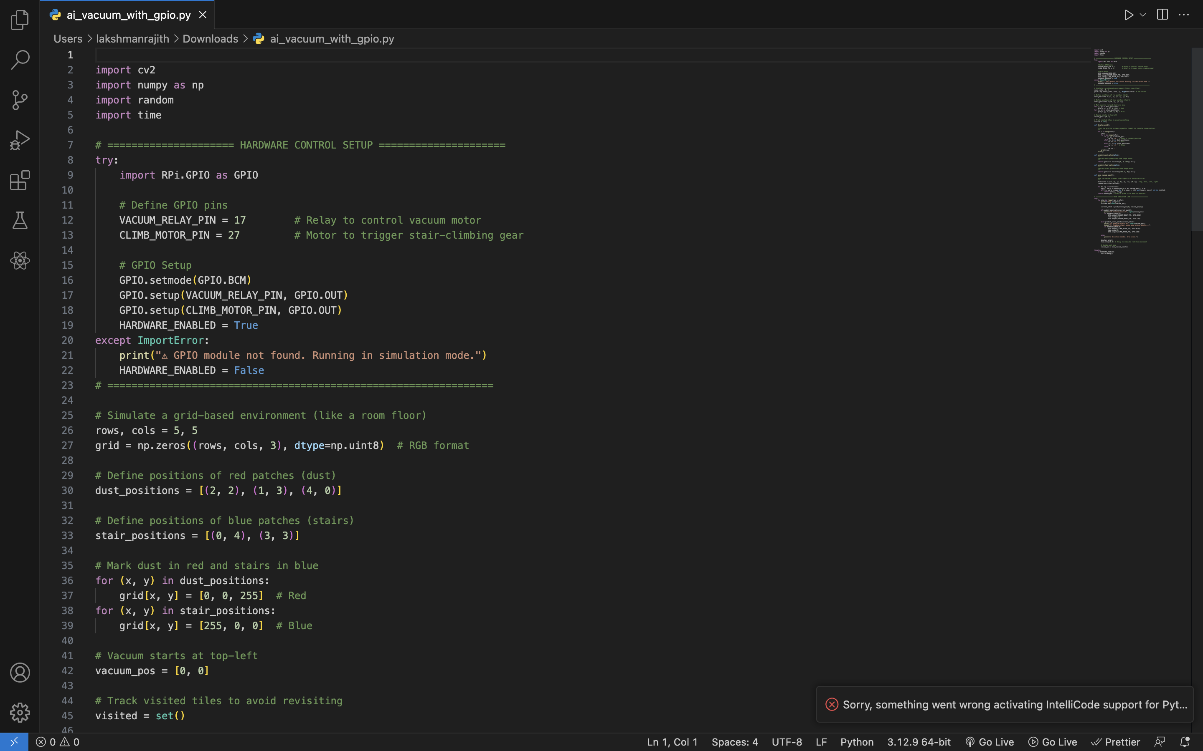

Slide 13
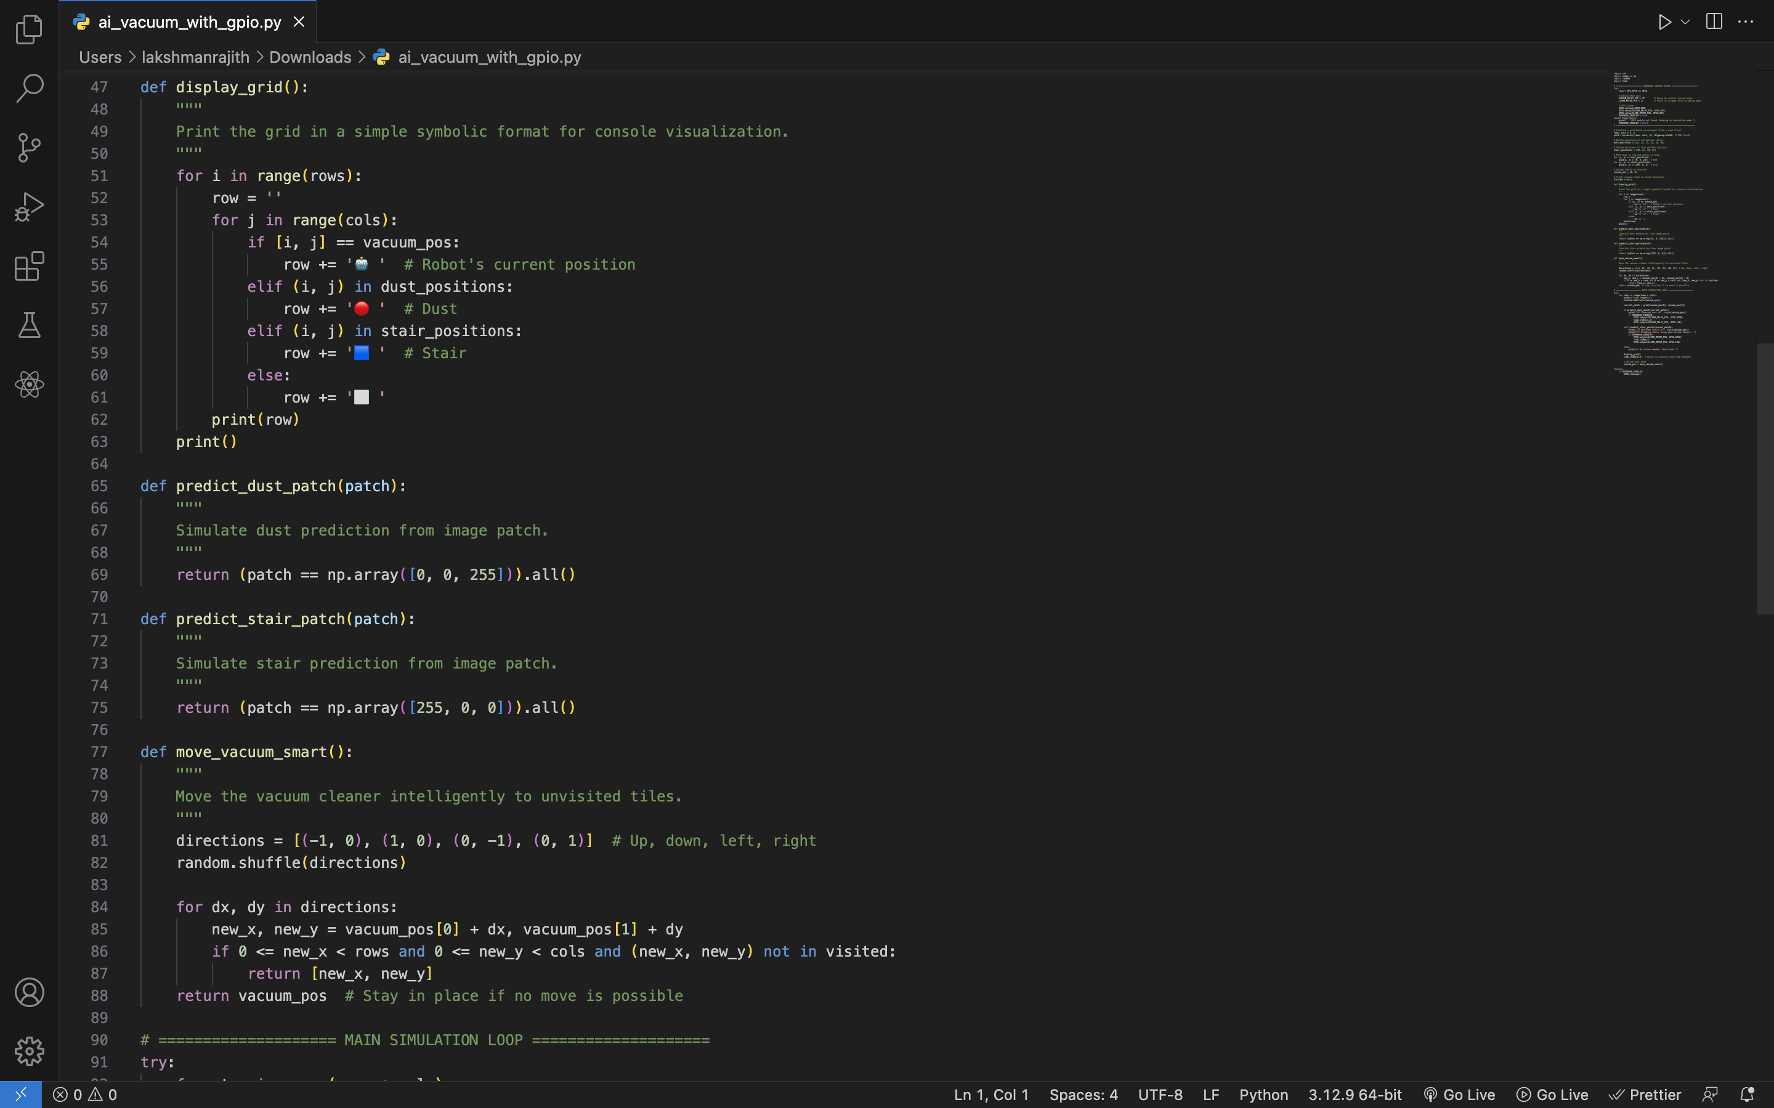

Slide 14
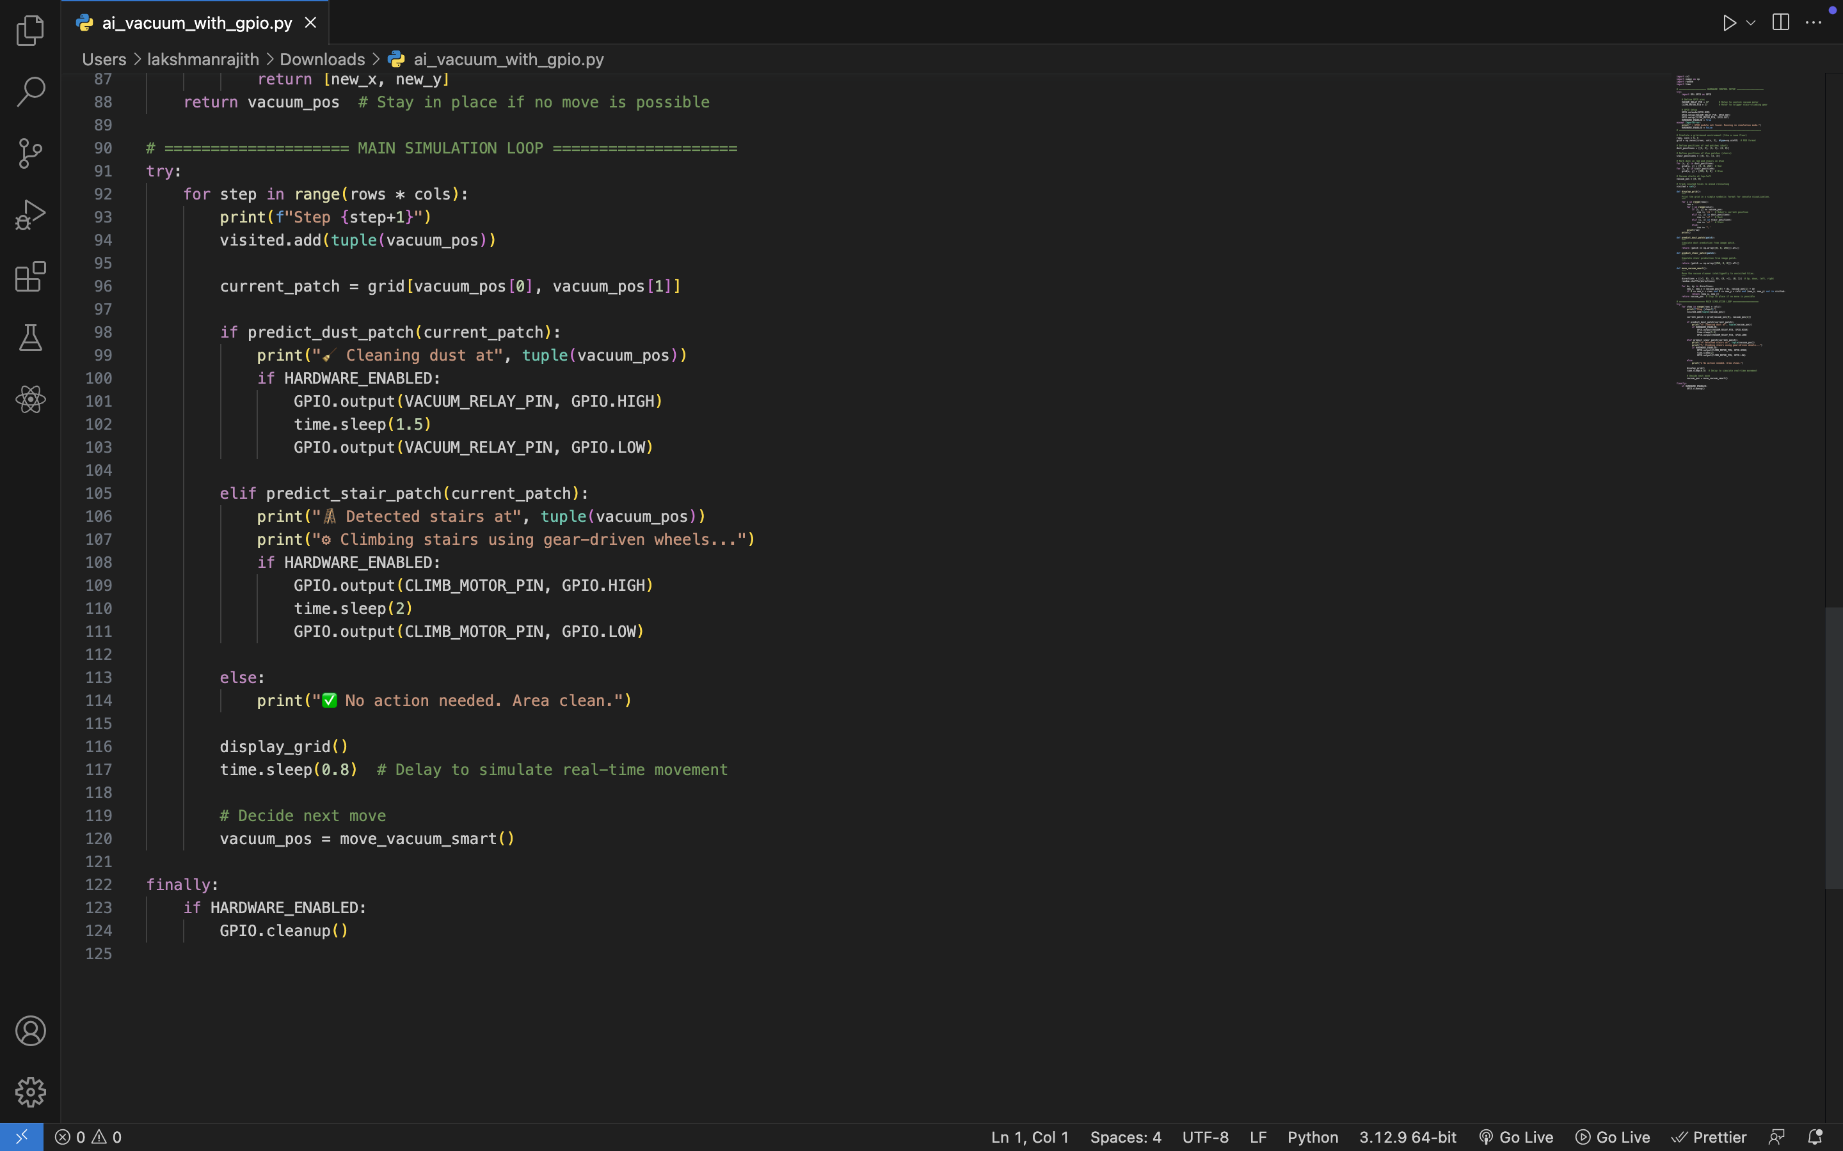

Slide 15
Summary and Learnings
We successfully designed and simulated an AI-powered vacuum cleaner system using Raspberry Pi. The setup integrates real-time camera input, CNN-based predictions, and Python-controlled GPIO logic to control vacuum and motor functions. While the full hardware prototype is under development, we have completed the software logic, wiring design, and component integration plan. This project gave us hands-on experience in AI vision, embedded system planning, hardware simulation, and smart robotics design — preparing us for full-scale physical deployment

Slide 16


